Slide 1
Data Engineering - Projects
Optimized Real-Time Data Processing with Caching,
Persisting, and Broadcasting
Comprehensive Data Analytics on MovieLens Dataset
Mano Ranjan Narayanasamy

Slide 2
Optimized Real-Time Data Processing with Caching,
Persisting, and Broadcasting

Slide 3
Objective
Optimize the performance of Apache Spark jobs by leveraging caching, persisting, and broadcasting strategies for efficient handling of large-scale data.
Enable robust data validation, metadata enrichment, and efficient storage in Google Cloud Storage (GCS) using JSON and Parquet formats.
Perform real-time data processing and store the insights into GCS

Slide 4
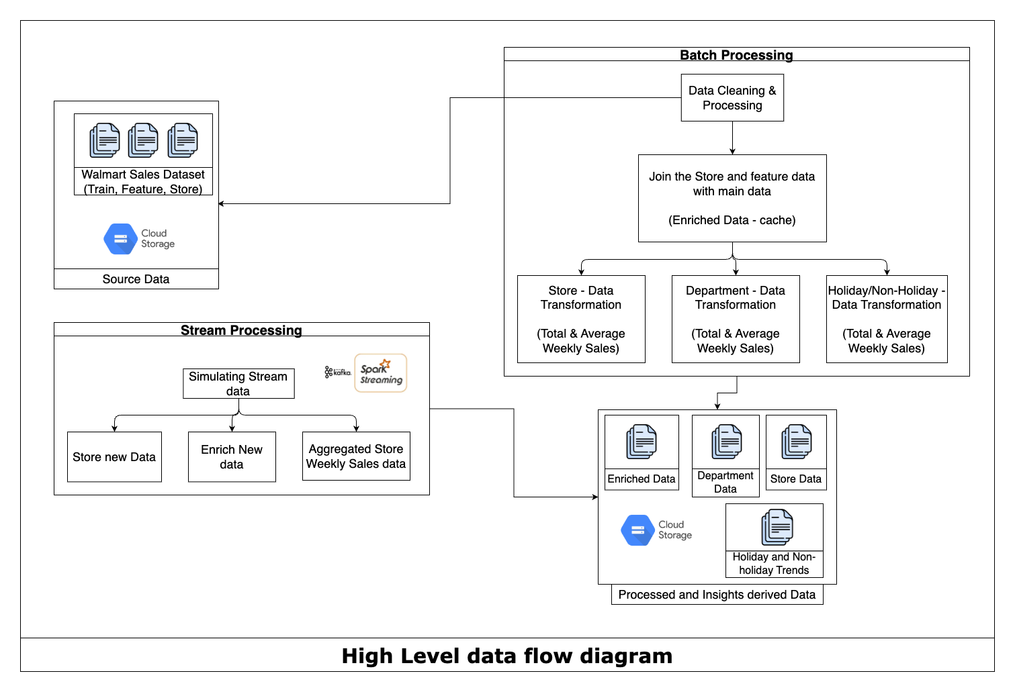
Architecture - Data Flow

Slide 5
Key Techniques
Data Validation & Enrichment
Cached Processed data for further usage
Broadcasted smaller data to all the nodes
Real-time Stream data processing
Batch Real-time updating the sales metric with new sales data
Optimized Data Storing for further analysis

Slide 6
Components
Datasets
Sales Analytics are performed on the walmart sales dataset
features.csv
stores.csv
train.csv
Spark:
Data from the CSV files (features.csv, stores.csv, train.csv) are loaded into Spark DataFrames for validation, transformation, and aggregation.
Employed Spark Streaming for handling the streaming data from stream source, eg: kafka.

Slide 7
Components
Google Cloud Storage
Enriched Dataset: The cumulative dataset, generated by combining raw data and the enrichment process, is stored in GCS in Parquet format, partitioned by storeId and date.
Aggregated Metrics: Key metrics, such as store-level, department-level, weekly trends, and holiday vs. non-holiday sales, are computed and stored in GCS in JSON format under the processed_data folder.
Kafka
Kafka is hosted and used as message broker system for receiving the sales sales new data.

Slide 8
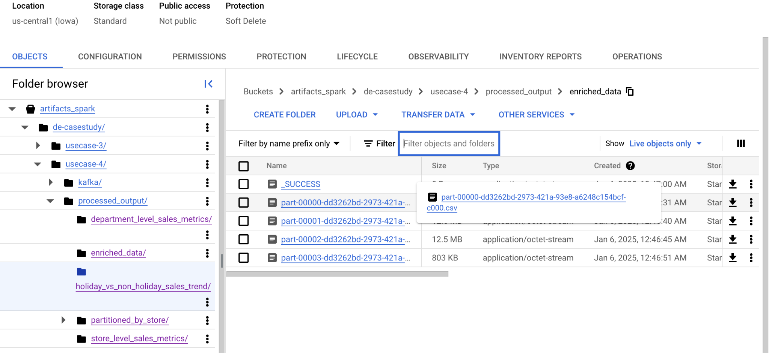
Enriched Data Storage

Slide 9
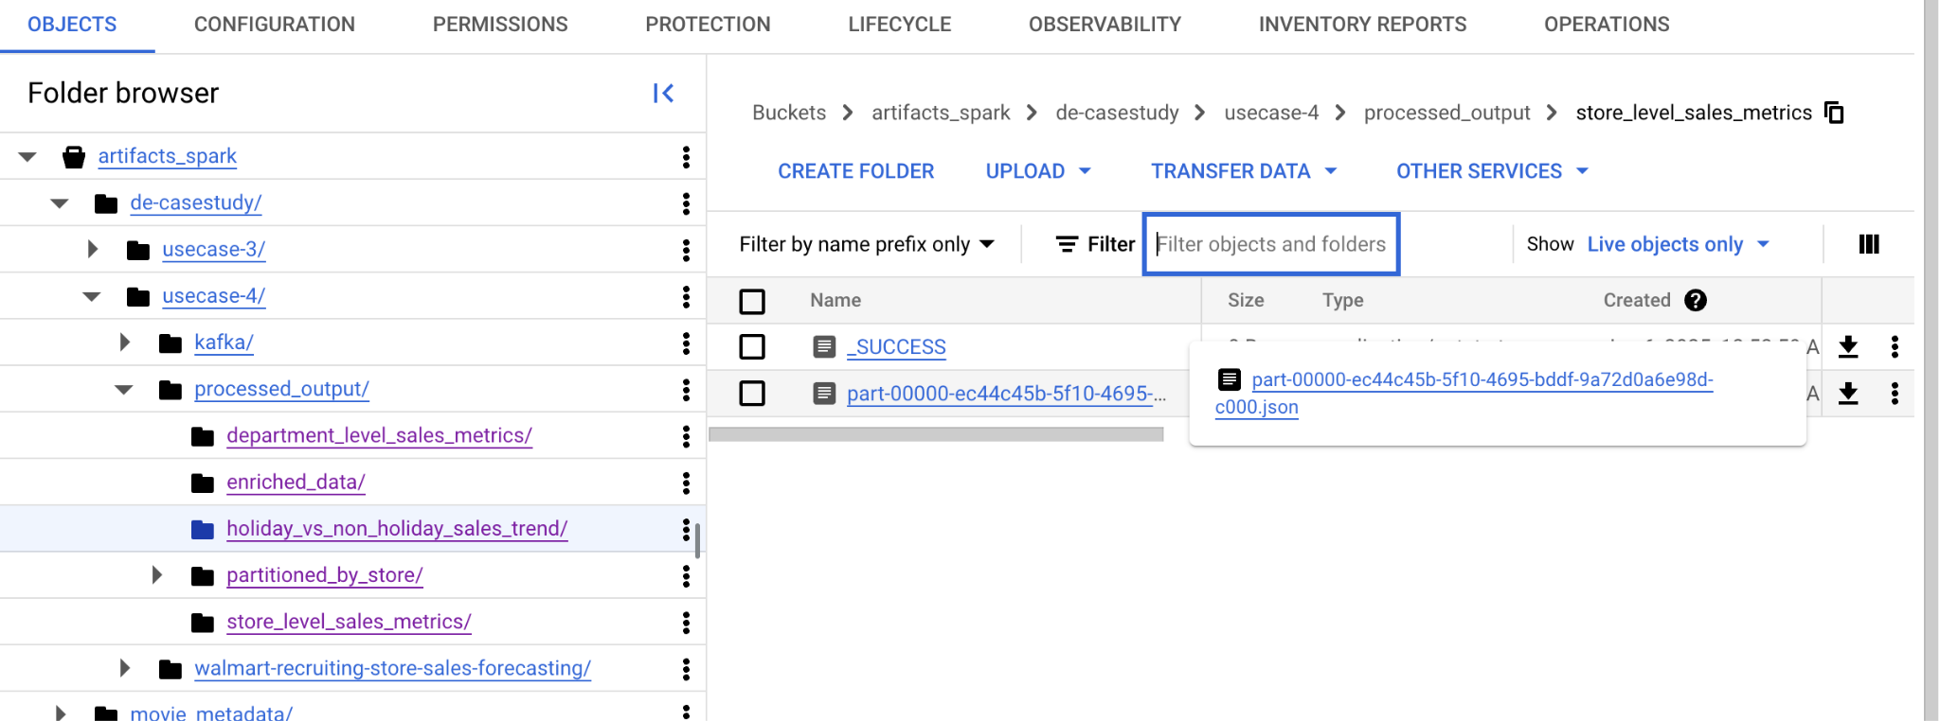
Aggregated Data Storage

Slide 10
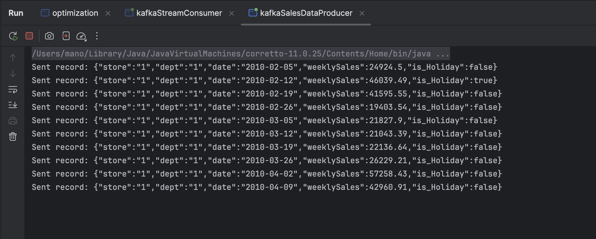
Real-time Data Processing
Kafka is used for streaming the weekly sales data.
Spark Streaming is used for consuming the data from the kafka topic and process the data and got stored into the cloud storage for further analysis.

Slide 11
Key Insights
Store - Level Insights
Metrics such as total and average weekly sales are calculated and stored for each store for further analysis.
Department - Level Insights
Metrics related to specific departments, like total sales within a department, are analyzed, computed and stored.

Slide 12
Key Insights
Holiday vs Non-Holiday sales insights:
Sales are compared between holiday periods and non-holiday periods to understand seasonal variations.
Weekly Trends Analysis:
Weekly sales trends are determined by comparing sales differences between consecutive weeks.

Slide 13
Key outcomes
Real-time synchronization of raw sales data with calculated insights from the streaming data.
Enhanced data storage efficiency using GCP-supported Parquet and JSON formats.
Accelerated data processing through advanced techniques such as broadcasting, caching, and persistence strategies.
Comprehensive insights enabled by scalable and optimized data storage solutions.

Slide 14
Comprehensive Data Analytics on MovieLens Dataset

Slide 15
Objective
Develop and implement a robust data pipeline using Spark to efficiently process and transform the large MovieLens dataset, ensuring high performance and scalability.
Conduct comprehensive data analysis to understand user behavior, movie popularity, genre trends, and rating patterns, revealing valuable insights into the movie recommendation domain.
Implement efficient data storage strategies, such as Parquet partitioning, to optimize data access and enable fast query performance for future analyses and applications.

Slide 16
Key Techniques
Data Validation and Enriching
Aggregation Operations like count, sum, variance, avg etc
Performing Window Aggregation Operation
Performing Machine Learning based Analysis on user activity
Anomaly Detection
Generating Visual Reports

Slide 17
Components
Datasets
Sales Analytics are performed on the walmart sales dataset
movies.csv
ratings.csv
tags.csv
links.csv
Spark:
Data from the CSV files (features.csv, stores.csv, train.csv) are loaded into Spark DataFrames for validation, transformation, and aggregation.
Spark Window Operation for deriving comprehensive insights from the data.

Slide 18
Components
Spark ML:
Employed Spark Machine Learning for clustering the similar user, using unsupervised learning methods.
Plotly:
Employed Visualization using plotly to create bar plot for the rolling Avg Year and avg By Year insights

Slide 19
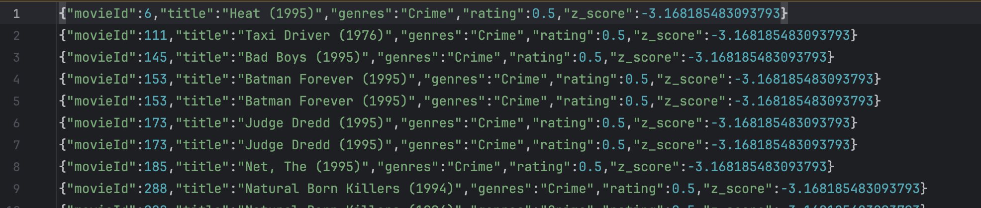
Genre By Rating Anomaly Detection

Slide 20
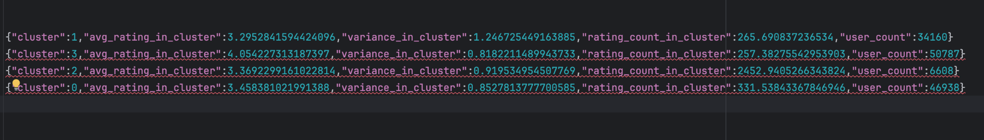
ML Based User Clustering By Rating behaviour

Slide 21
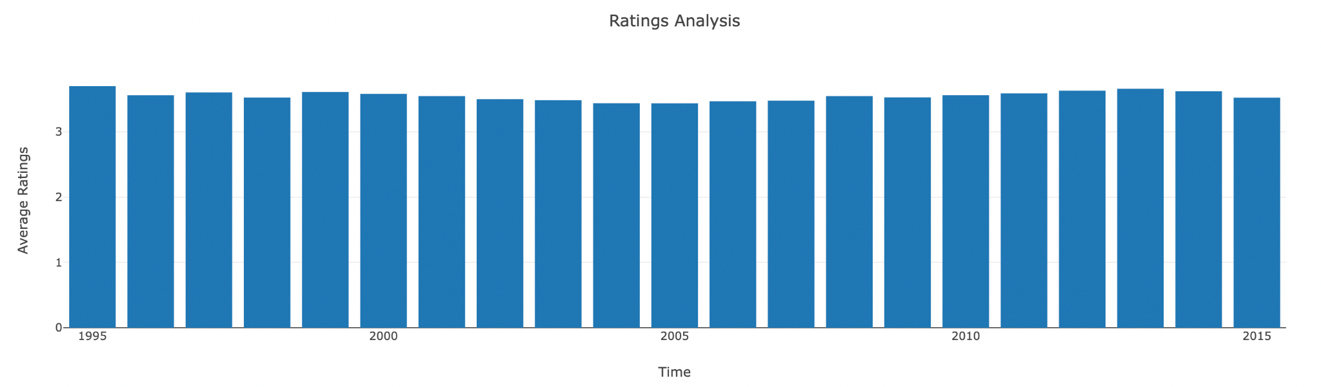
Visual Reports - Average Rating By Year

Slide 22
Key Insights - Users
Identified the top users contributing the most ratings, showcasing patterns of highly engaged users.
Users tagged movies with common themes such as "classic" or "must-watch," reflecting shared sentiments across the community.
Users were clustered based on their rating behavior, revealing distinct preferences like favoring specific genres or consistent high ratings.

Slide 23
Key Insights - Movies
Top 10 movies with the highest average ratings (minimum 50 ratings), highlighting community favorites.
Time-based trends showed how some movies gained popularity over time, likely due to cultural events or online buzz.
Movies with the highest rating variance suggest polarizing content that divided audience opinions.

Slide 24
Key Insights - Genres
Popular Genres: Genre with the highest total ratings and average rating scores, indicating community preferences.
Anomalies Detected: Unusual spikes or drops in ratings for genres, likely caused by outlier data or significant cultural events.
Yearly Trends: Pivot analysis showed shifts in genre preferences over decades (e.g., rising interest in sci-fi movies).

Slide 25
THANK YOU

